Slide 1
Curso: Aprendizagem de Máquina em Inteligência Artificial
Disciplina: Classificação
Prof. Bruno Silva

Slide 2
Objetivos da Aula
Estado da Arte em IA
1943 - Redes Neurais
1957 - Backpropagation
1970 - CNN, MNIST, LSTM, Bidirectional RNN
2006 - Deep Learning
2009 - ImageNet
2014 - GANs
2016 - AlphaGO ...

Slide 3
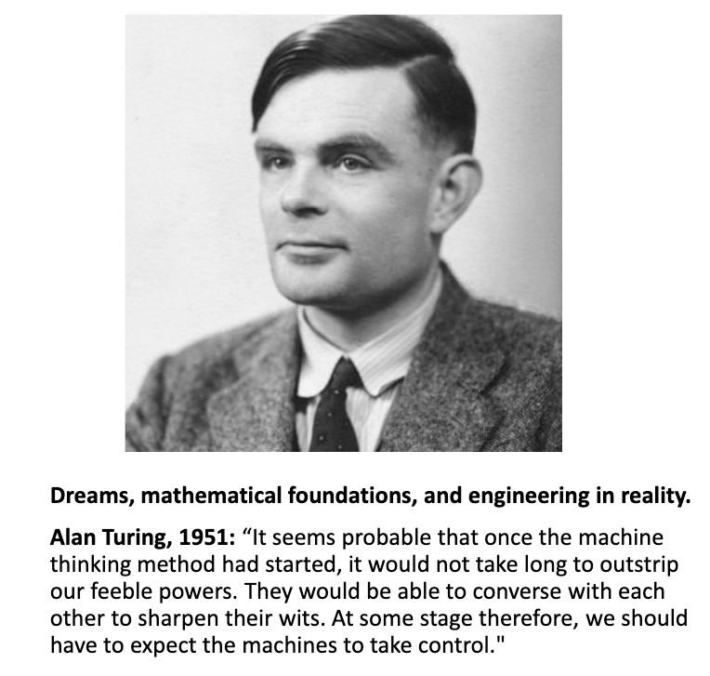
AI and Human History

Slide 4
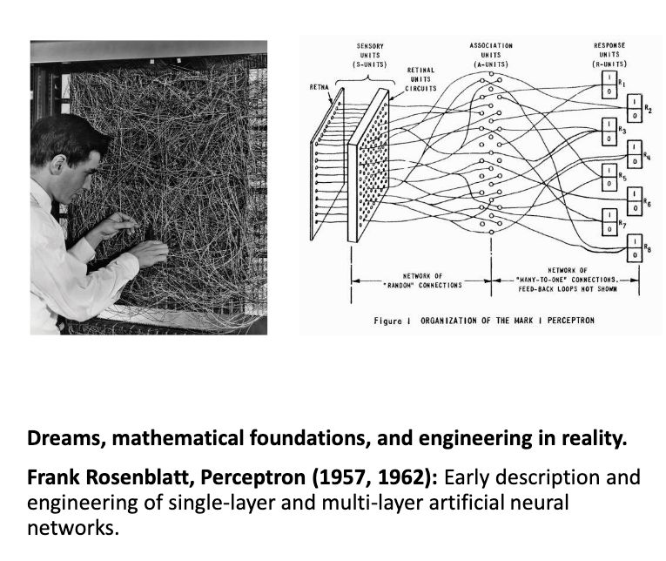
AI and Human History

Slide 5
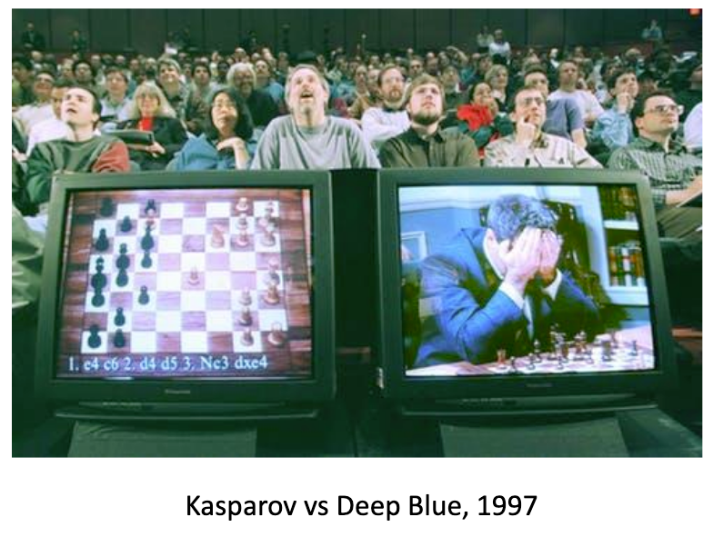
AI and Human History

Slide 6
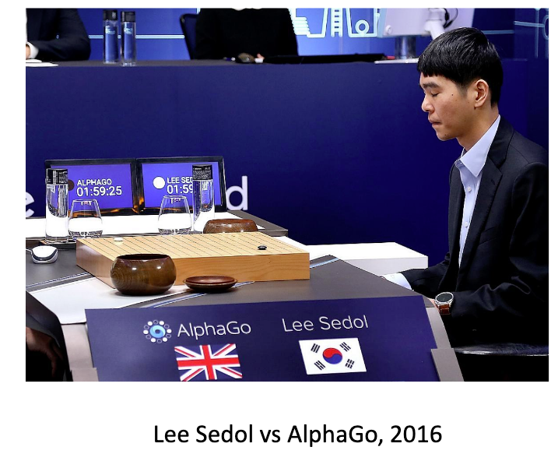
AI and Human History

Slide 7
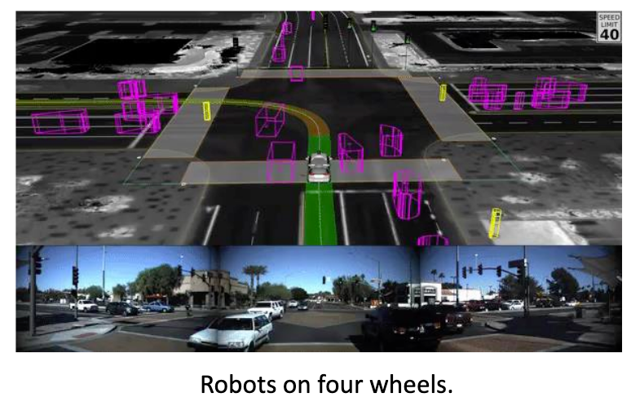
AI and Human History
https://www.youtube.com/watch?v=4eIBisqx9_g

Slide 8

AI and Human History

Slide 9
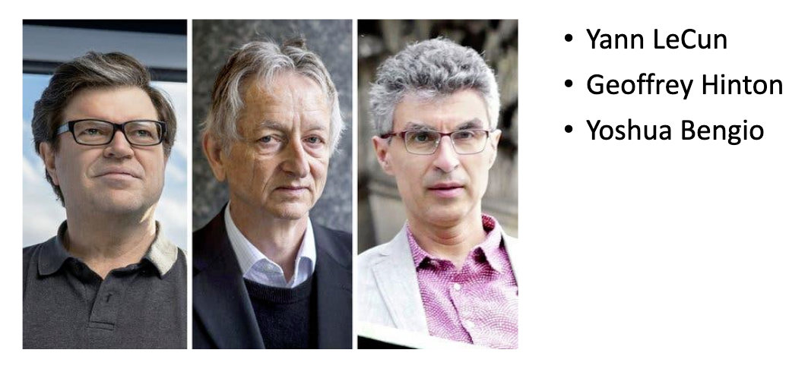
Turing Award for Deep Learning

Slide 10
Conceitos Chaves de Deep Learning
•1943: Walter Pitts and Warren McCulloch
Computational models for neural nets
•1957, 1962: Frank Rosenblatt
Perceptron (Single-Layer & Multi-Layer)
•1965: Alexey Ivakhnenkoand V. G. Lapa
Learning algorithm for MLP
•1970: Seppo Linnainmaa
Backpropagation and automatic differentiation
•1979: KunihikoFukushima
Convolutional neural networks
•1982: John Hopfield
Hopfield networks (recurrent neural networks)

Slide 11
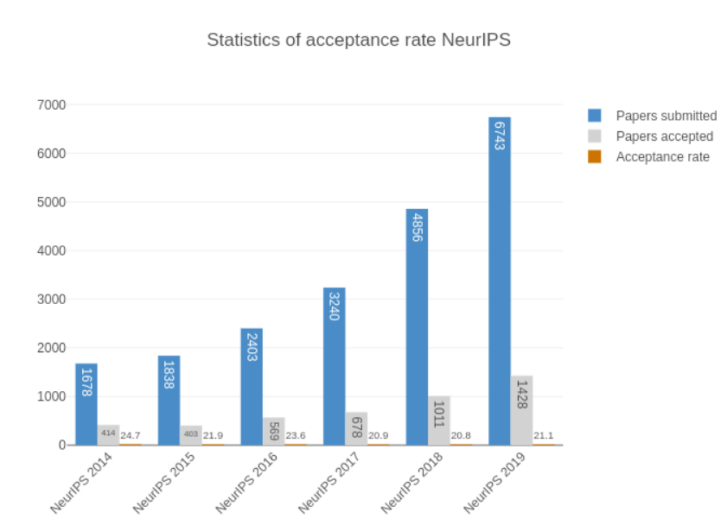
Deep learning Community

Slide 12
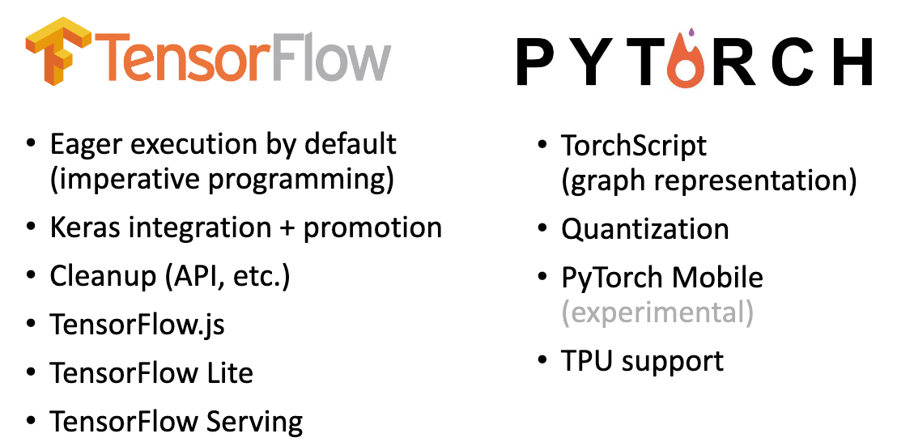
Plataformas Deep Learning

Slide 13
GANs - Generative Adversarial Networks
https://junyanz.github.io/CycleGAN/

Slide 14
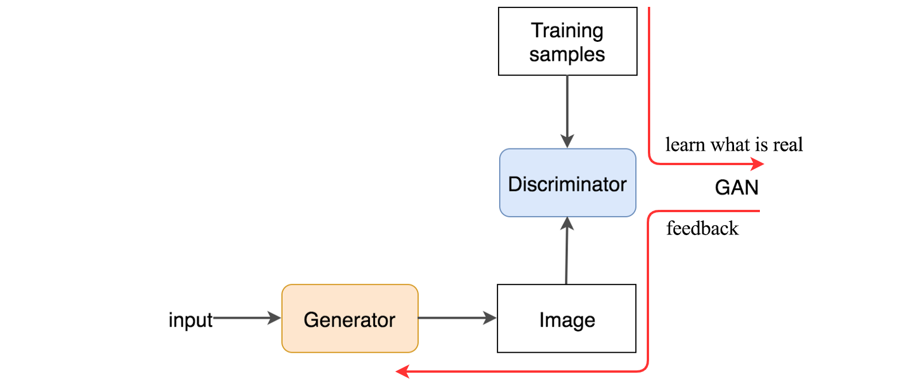

GANs
https://medium.com/@jonathan_hui/gan-whats-generative-adversarial-networks-and-its-application-f39ed278ef09

Slide 15
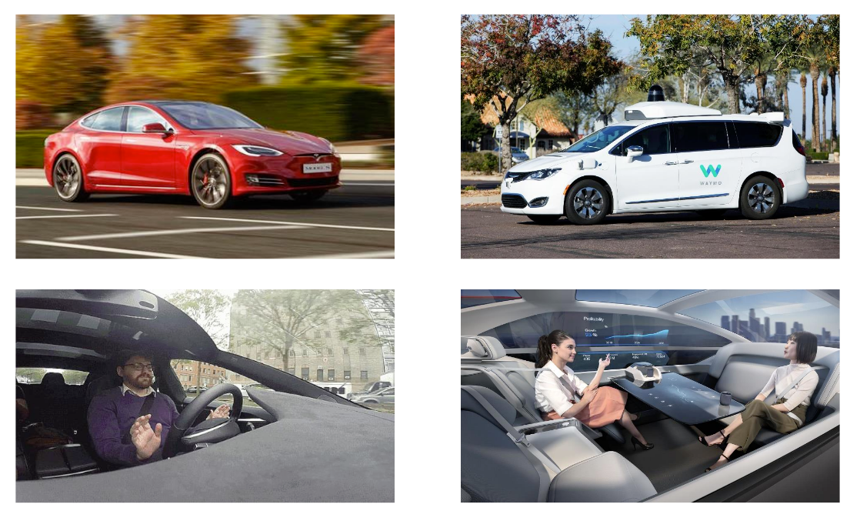
Ainda há muito a se percorer

Slide 16
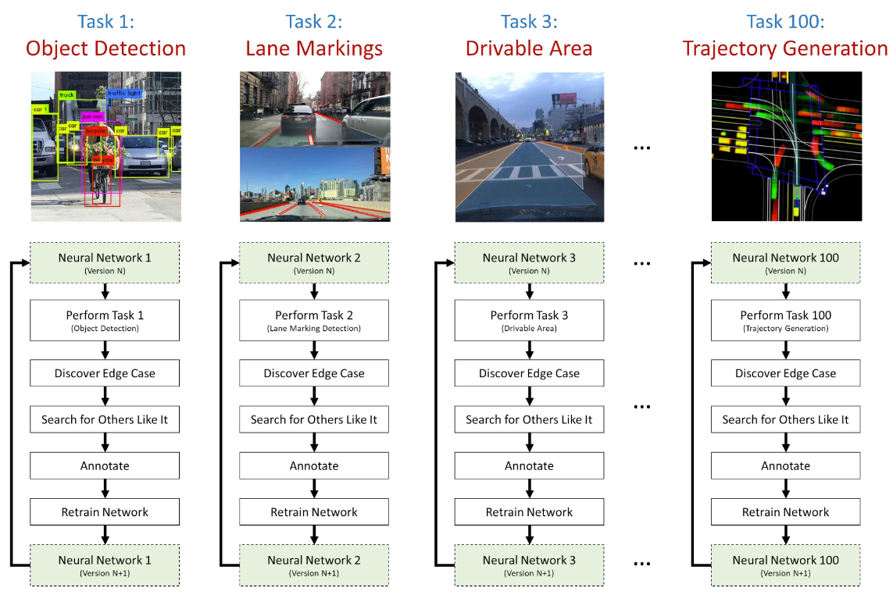
IA Monotarefa

Slide 17
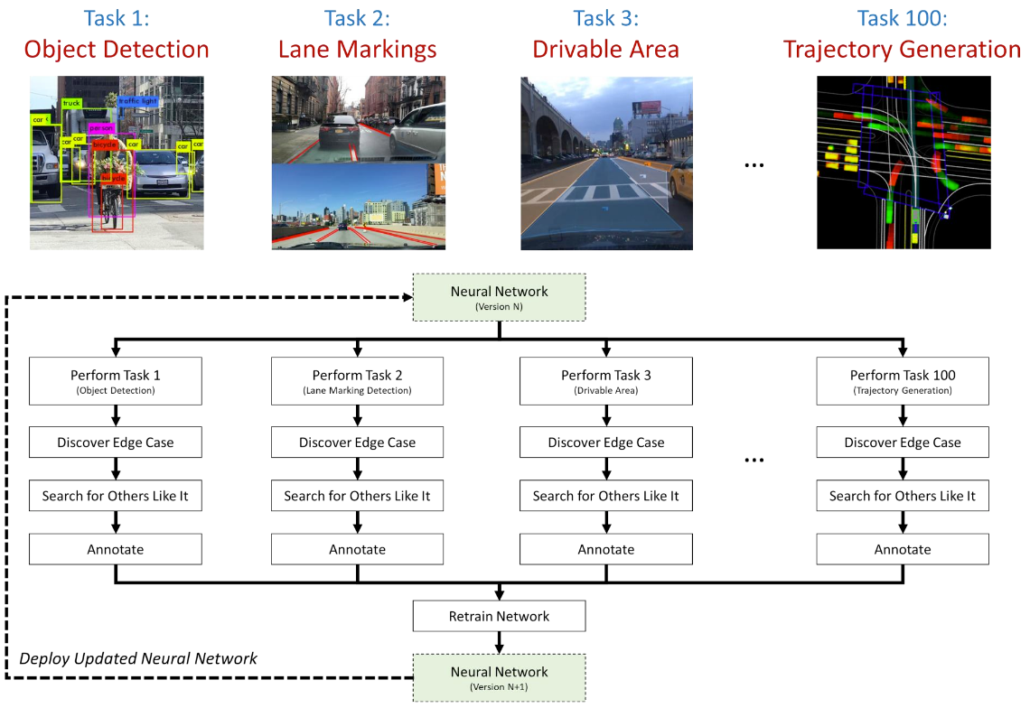
IA Multitarefa

Slide 18
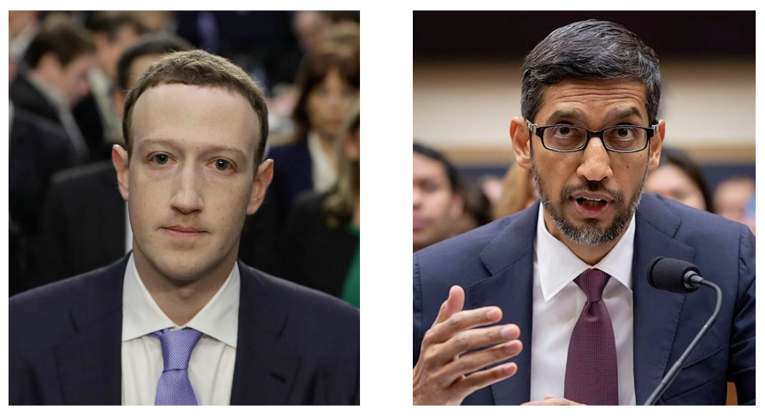
IA e Ética

Slide 19
OBRIGADO! Prof Bruno Silva email sbruno@br.ibm.com
Até a próxima aula – estudar...

